Slide 1

Cross-Validation-Lecture Python
Data Analytics Department Bridgerland Technical College

Slide 2
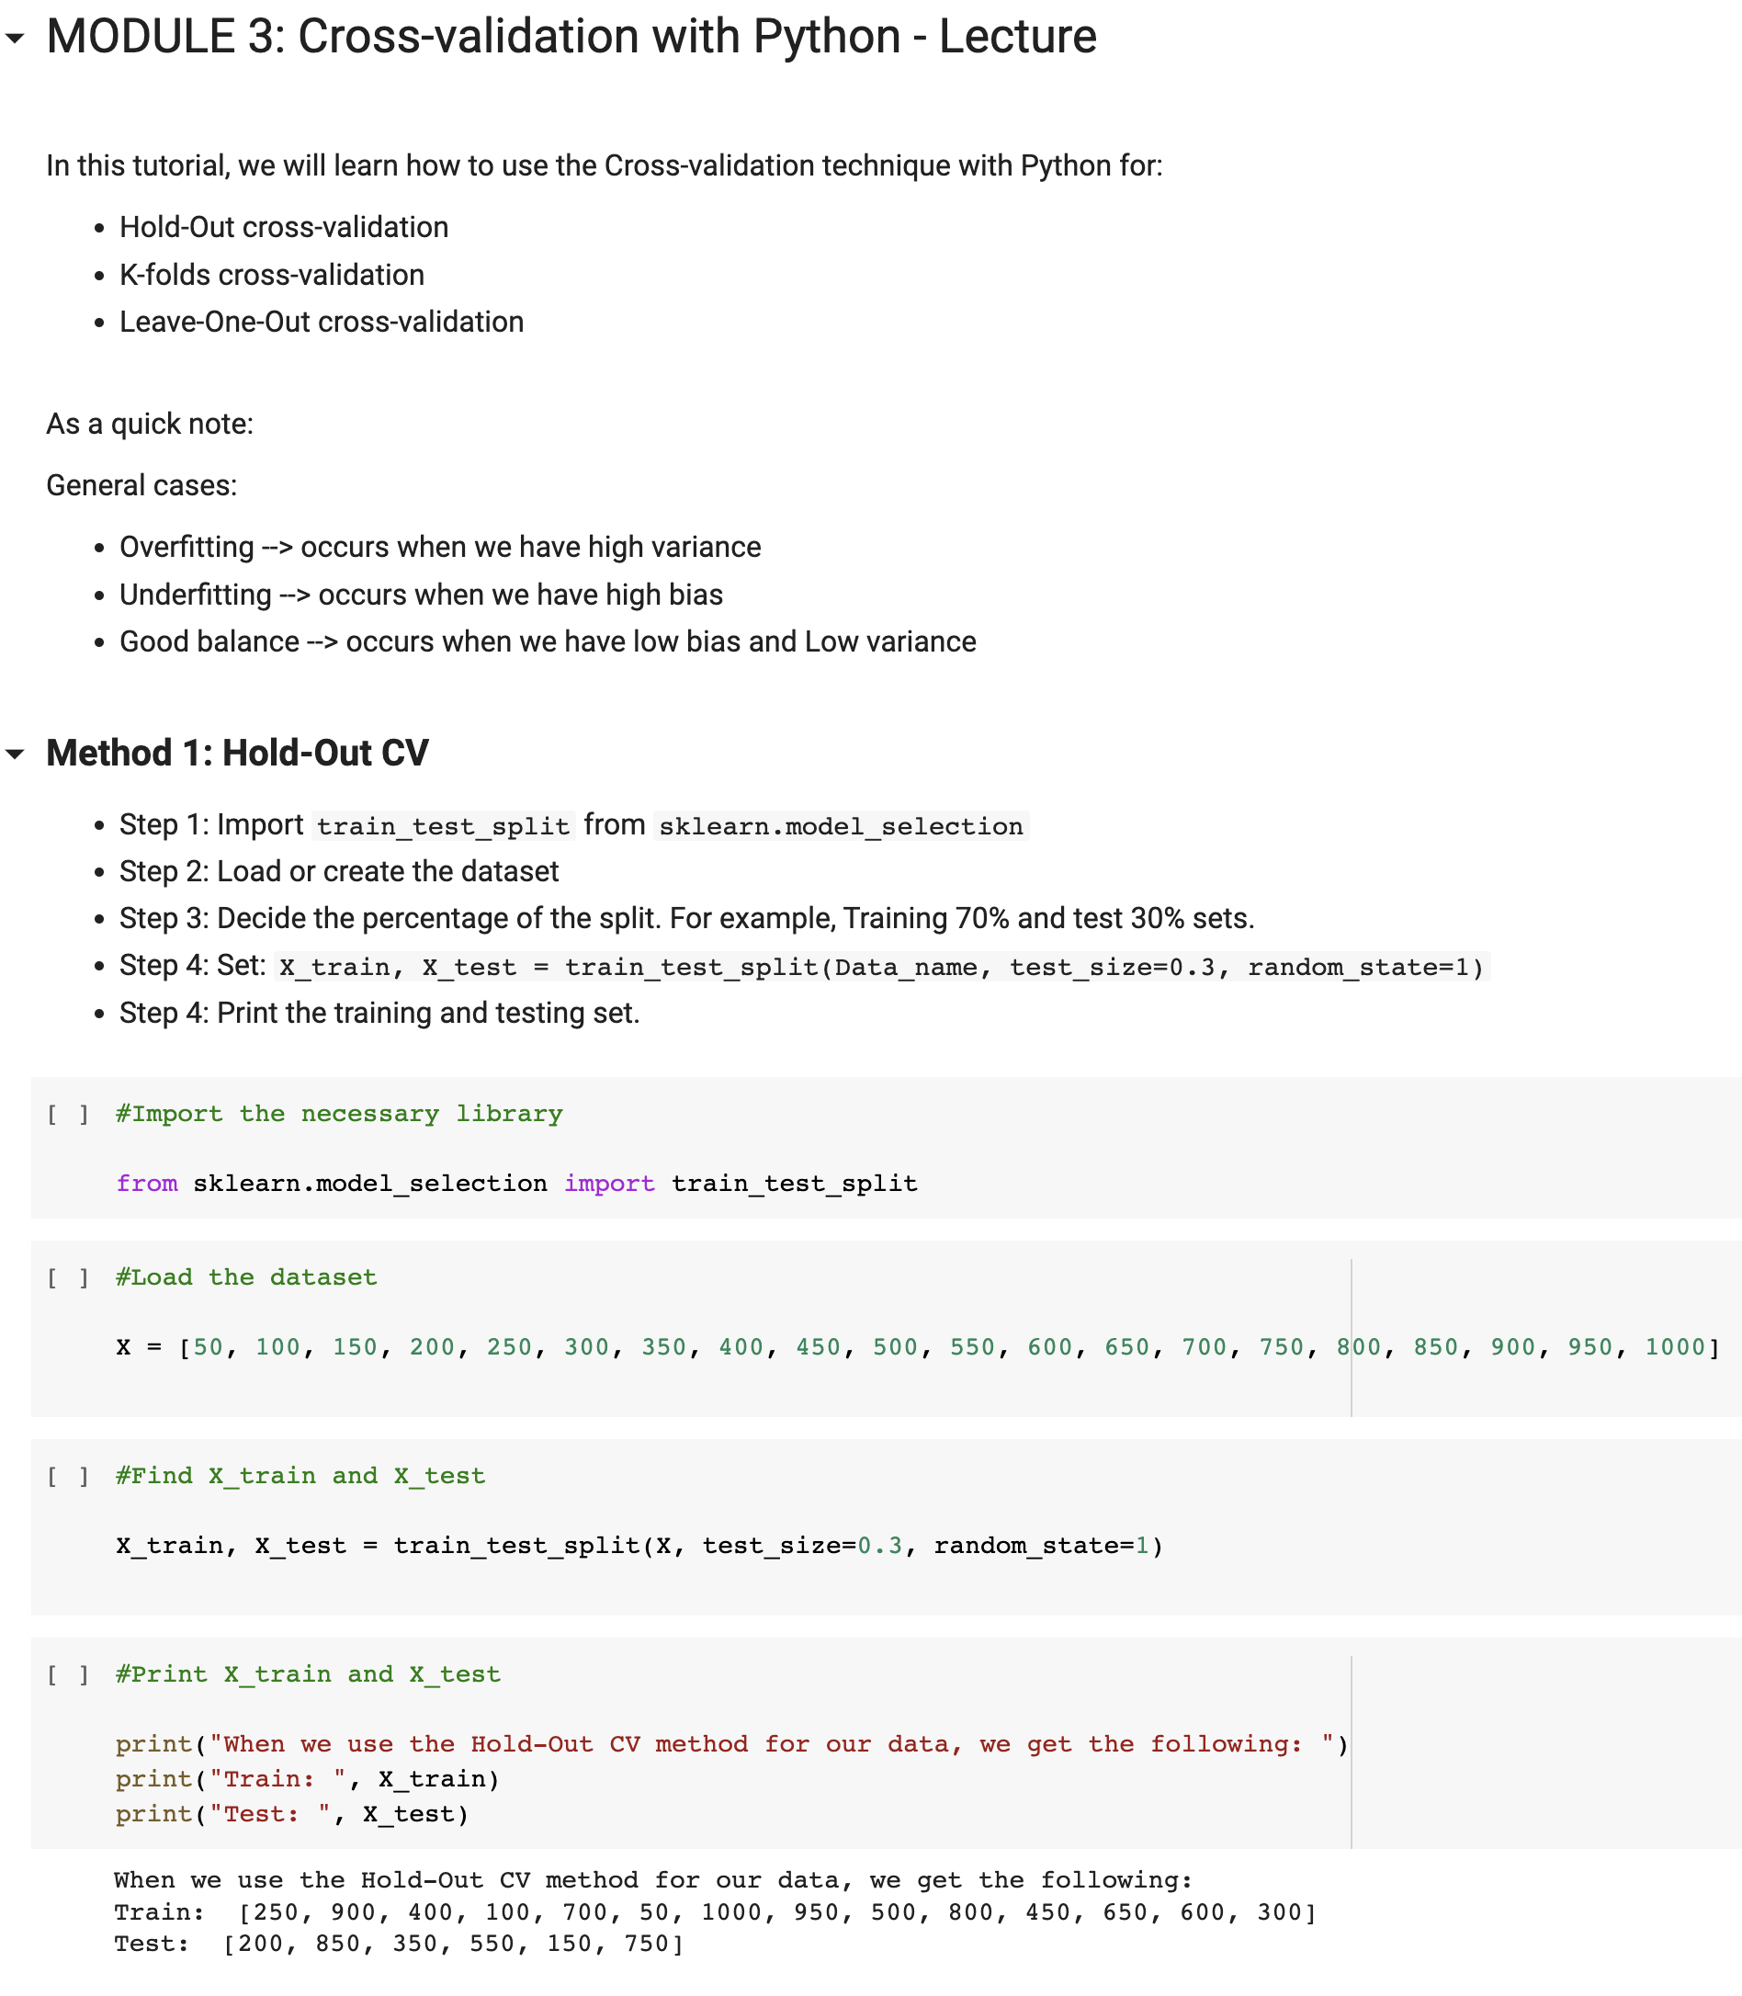

Slide 3
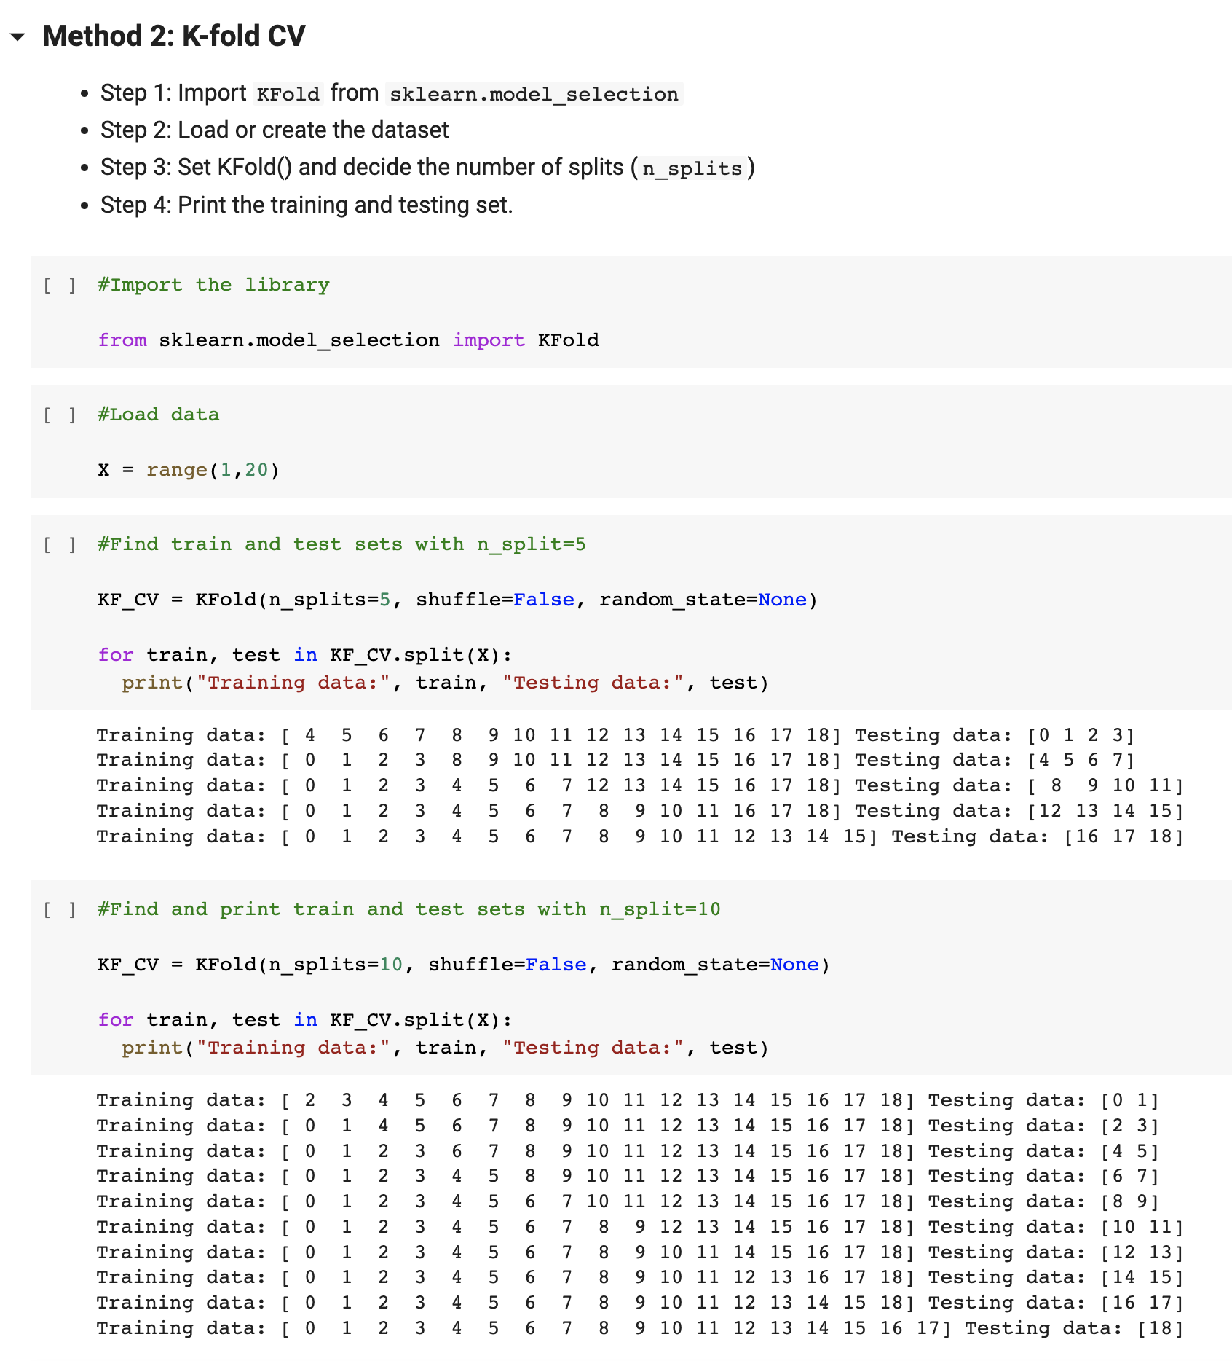

Slide 4
